Slide 1

Dimentionality Reduction

Slide 2

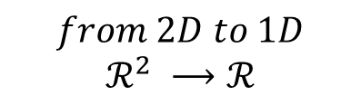
Motivation
Data Compression
y
y
y
x
x
x
$$from 2D to 1D$$
$$ℛ^{2} ⟶ℛ$$
Notes:
Ask the student “where is the most variation of the data in figures?”
Make them note that there is more variation along the orange line so by projecting the data along that line we can present most of the existed relationships among the points.
Draw the projection of the data on the orange line simulating the compression from 2d to 1d

Slide 3
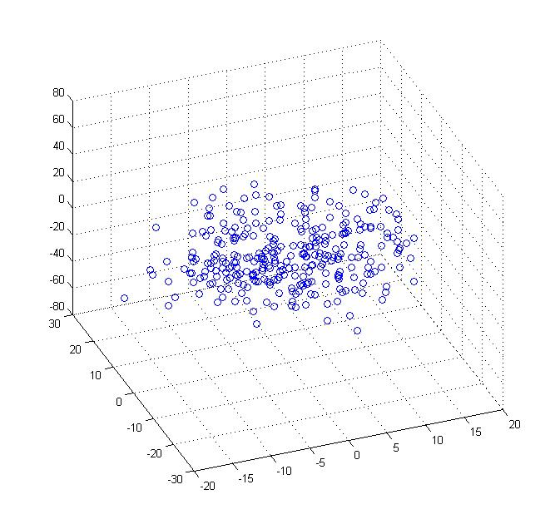
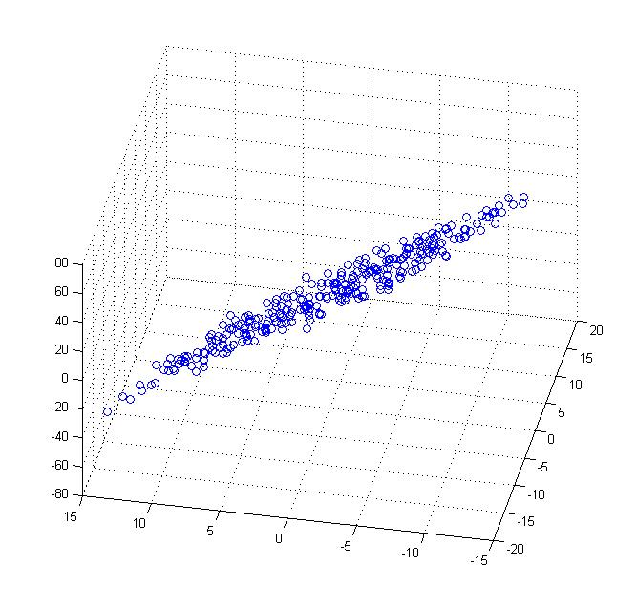
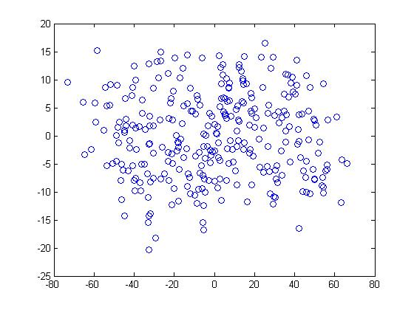





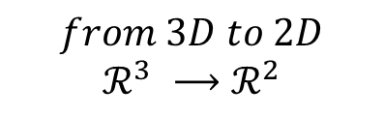
$$from 3D to 2D$$
$$ℛ^{3} ⟶ℛ^{2}$$
Notes:
Draw a 2d plain along the data in figure 2 to demonstrate the reduction

Slide 4
Data Visualization
longitude | latitude | housing_median_age | total_rooms | total_bedrooms | population | households | median_income | median_house_value | ocean_proximity
-122.23 | 37.88 | 41 | 880 | 129 | 322 | 126 | 8.3252 | 452600 | NEAR BAY
-122.22 | 37.86 | 21 | 7099 | 1106 | 2401 | 1138 | 8.3014 | 358500 | NEAR BAY
-122.24 | 37.85 | 52 | 1467 | 190 | 496 | 177 | 7.2574 | 352100 | NEAR BAY
-122.25 | 37.85 | 52 | 1274 | 235 | 558 | 219 | 5.6431 | 341300 | NEAR BAY
-122.25 | 37.85 | 52 | 1627 | 280 | 565 | 259 | 3.8462 | 342200 | NEAR BAY
-122.25 | 37.85 | 52 | 919 | 213 | 413 | 193 | 4.0368 | 269700 | NEAR BAY
-122.25 | 37.84 | 52 | 2535 | 489 | 1094 | 514 | 3.6591 | 299200 | NEAR BAY
-122.25 | 37.84 | 52 | 3104 | 687 | 1157 | 647 | 3.12 | 241400 | NEAR BAY
-122.26 | 37.84 | 42 | 2555 | 665 | 1206 | 595 | 2.0804 | 226700 | NEAR BAY
-122.25 | 37.84 | 52 | 3549 | 707 | 1551 | 714 | 3.6912 | 261100 | NEAR BAY
-122.26 | 37.85 | 52 | 2202 | 434 | 910 | 402 | 3.2031 | 281500 | NEAR BAY
-122.26 | 37.85 | 52 | 3503 | 752 | 1504 | 734 | 3.2705 | 241800 | NEAR BAY
-122.26 | 37.85 | 52 | 2491 | 474 | 1098 | 468 | 3.075 | 213500 | NEAR BAY
-122.26 | 37.84 | 52 | 696 | 191 | 345 | 174 | 2.6736 | 191300 | NEAR BAY
-122.26 | 37.85 | 52 | 2643 | 626 | 1212 | 620 | 1.9167 | 159200 | NEAR BAY
-122.26 | 37.85 | 50 | 1120 | 283 | 697 | 264 | 2.125 | 140000 | NEAR BAY
-122.27 | 37.85 | 52 | 1966 | 347 | 793 | 331 | 2.775 | 152500 | NEAR BAY
-122.27 | 37.85 | 52 | 1228 | 293 | 648 | 303 | 2.1202 | 155500 | NEAR BAY
……
……
……
……
……
……
……
……
……
……
……
……
……
……
……
……
……
……
……
Notes:
Ask “ How do we visualize that?! ” more than 10 features more than 10 dimensions
We human can’t visualize more than 3D.

Slide 5
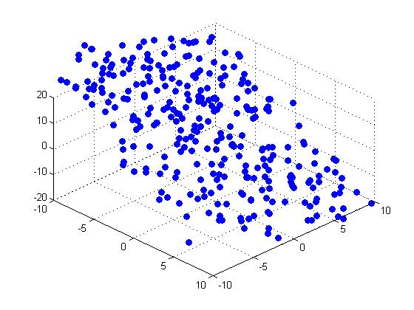

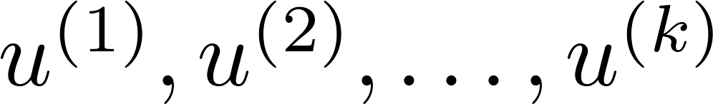
Principal Component Analysis problem formulation
y
x
Reduce from 2-dimension to 1-dimension: Find a direction (a vector )
onto which to project the data so as to minimize the projection error.
In general:
Reduce from n-dimension to k-dimension: Find vectors
onto which to project the data, so as to minimize the projection error.
Notes:
Draw the projection error as the perpendicular distance from the points to the line.

Slide 6
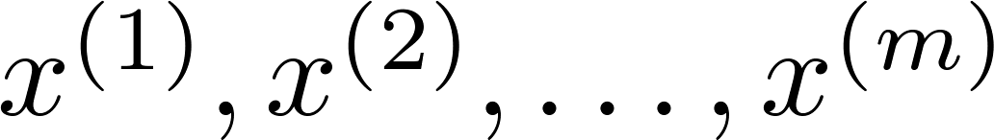
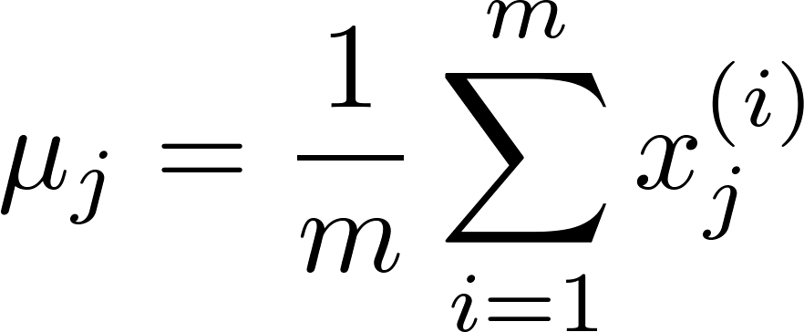
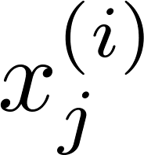



Data preprocessing
Why?!
Training set:
Preprocessing (feature scaling/mean normalization):
Replace each with .
If different features on different scales (e.g., median age of house, number of bedrooms), scale features to have comparable range of values.
Notes:
Because some scales makes their features affecting the projection vector than others e.g. [0,100] scale and {1,2,3,4,5} scale.
comparable range of values

Slide 7
SVD

Slide 8
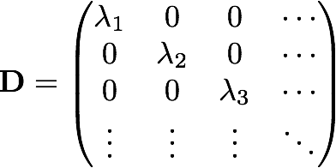
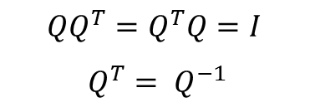
Linear algebra revisited
Orthogonal matrix
In linear algebra, an orthogonal matrix or real orthogonal matrix is a square matrix with real entries whose columns and rows are orthogonal unit vectors (i.e., orthonormal vectors), i.e.
Diagonal matrix
Is a matrix in which the entries outside the main diagonal are all zero.
$$QQ^{T}=Q^{T}Q=I$$
$$Q^{T}= Q^{−1}$$

Slide 9
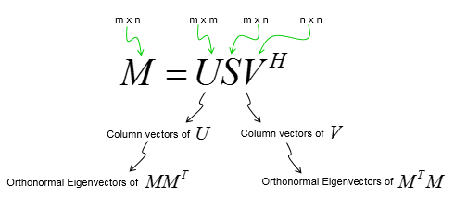
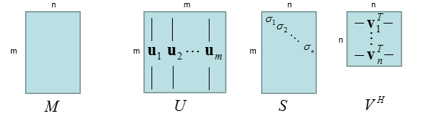
SVD
Rotation
Stretching
Rotation

Slide 10
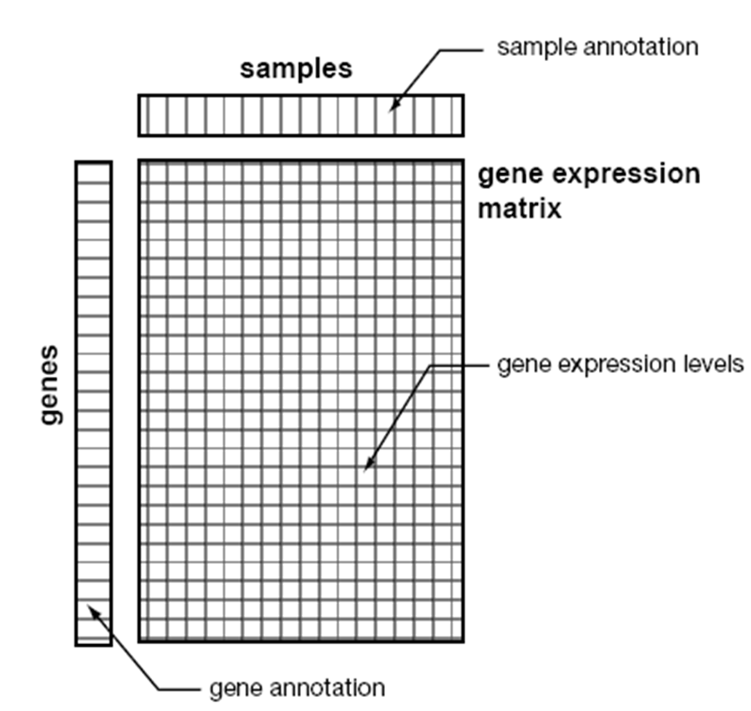
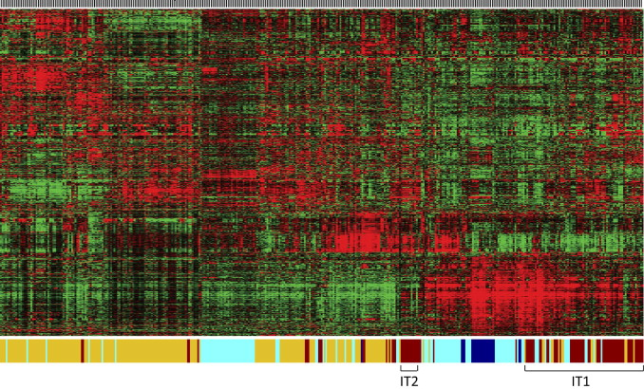
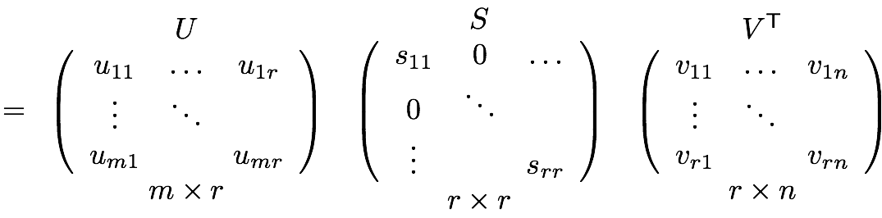
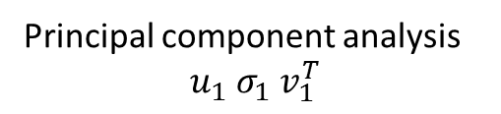
Appling SVD
Principal component analysis
$$u_{1} σ_{1} v_{1}^{T}$$
Gene Expression Matrix
Notes:
Mention that the biggest singular value it has the most information.
Draw a vector representing this.

Slide 11


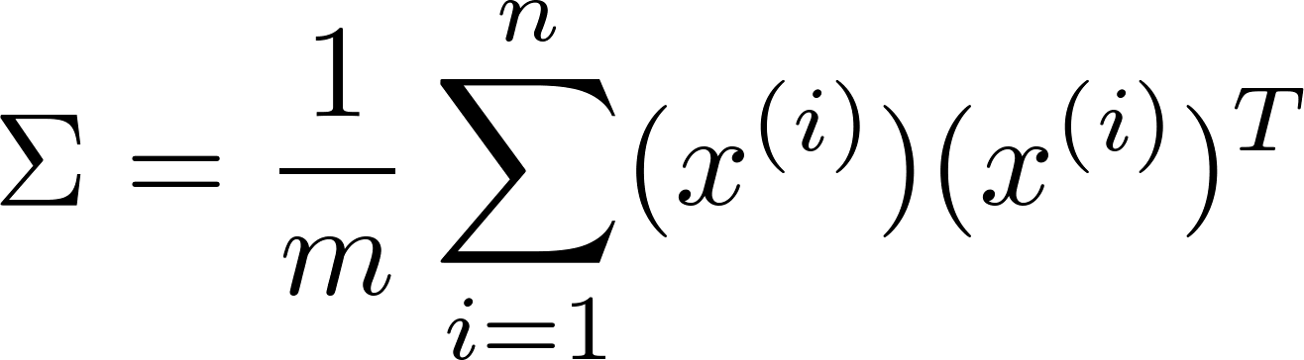


Principal Component Analysis (PCA) algorithm
Reduce data from -dimensions to -dimensions
Compute “covariance matrix”:
Compute “eigenvectors” of matrix :
python implementation
Notes:
Draw the projection and the selection of U reduce (first k columns vector) and note that the Xs is (nx1) so the sigma (covariance matrix is nxn).

